Slide 1
Chapter 14

Slide 2
Objectives

Slide 3
Objectives (cont.)

Slide 4
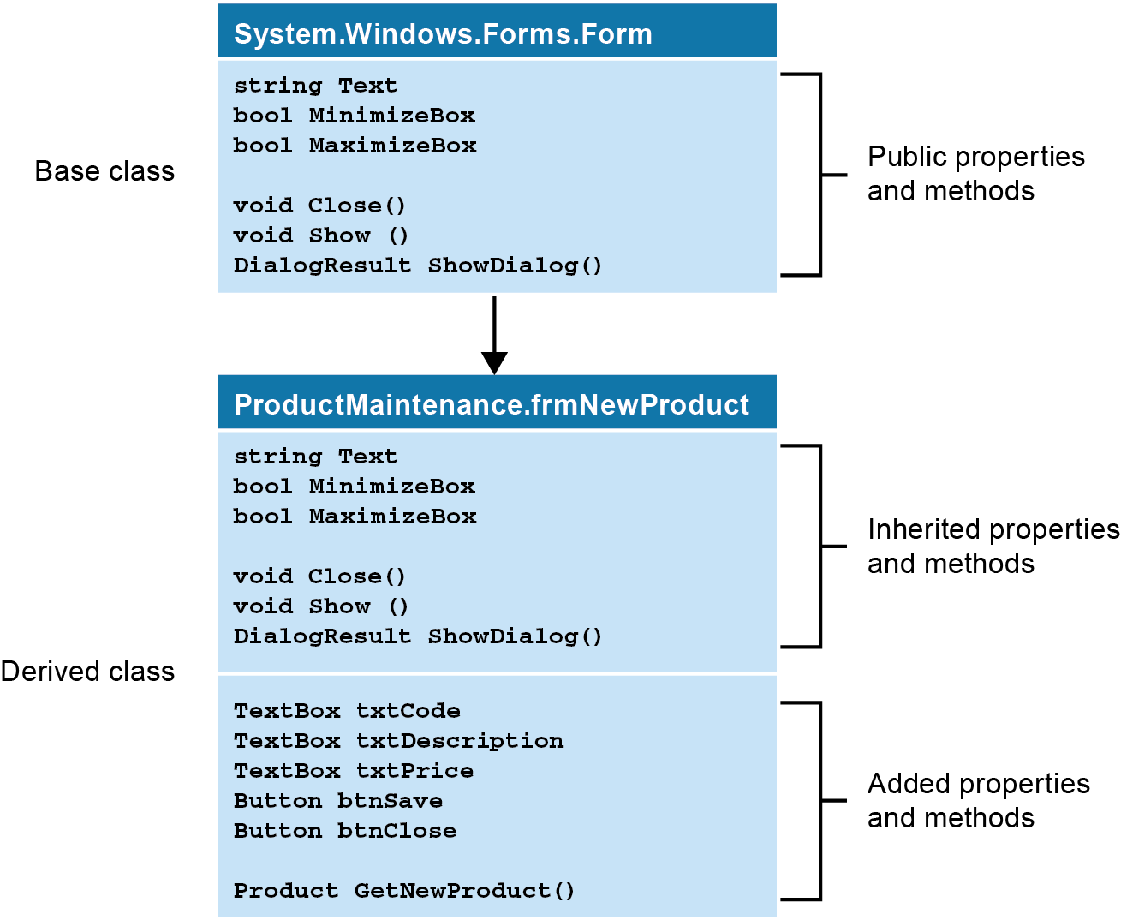
How inheritance works

Slide 5
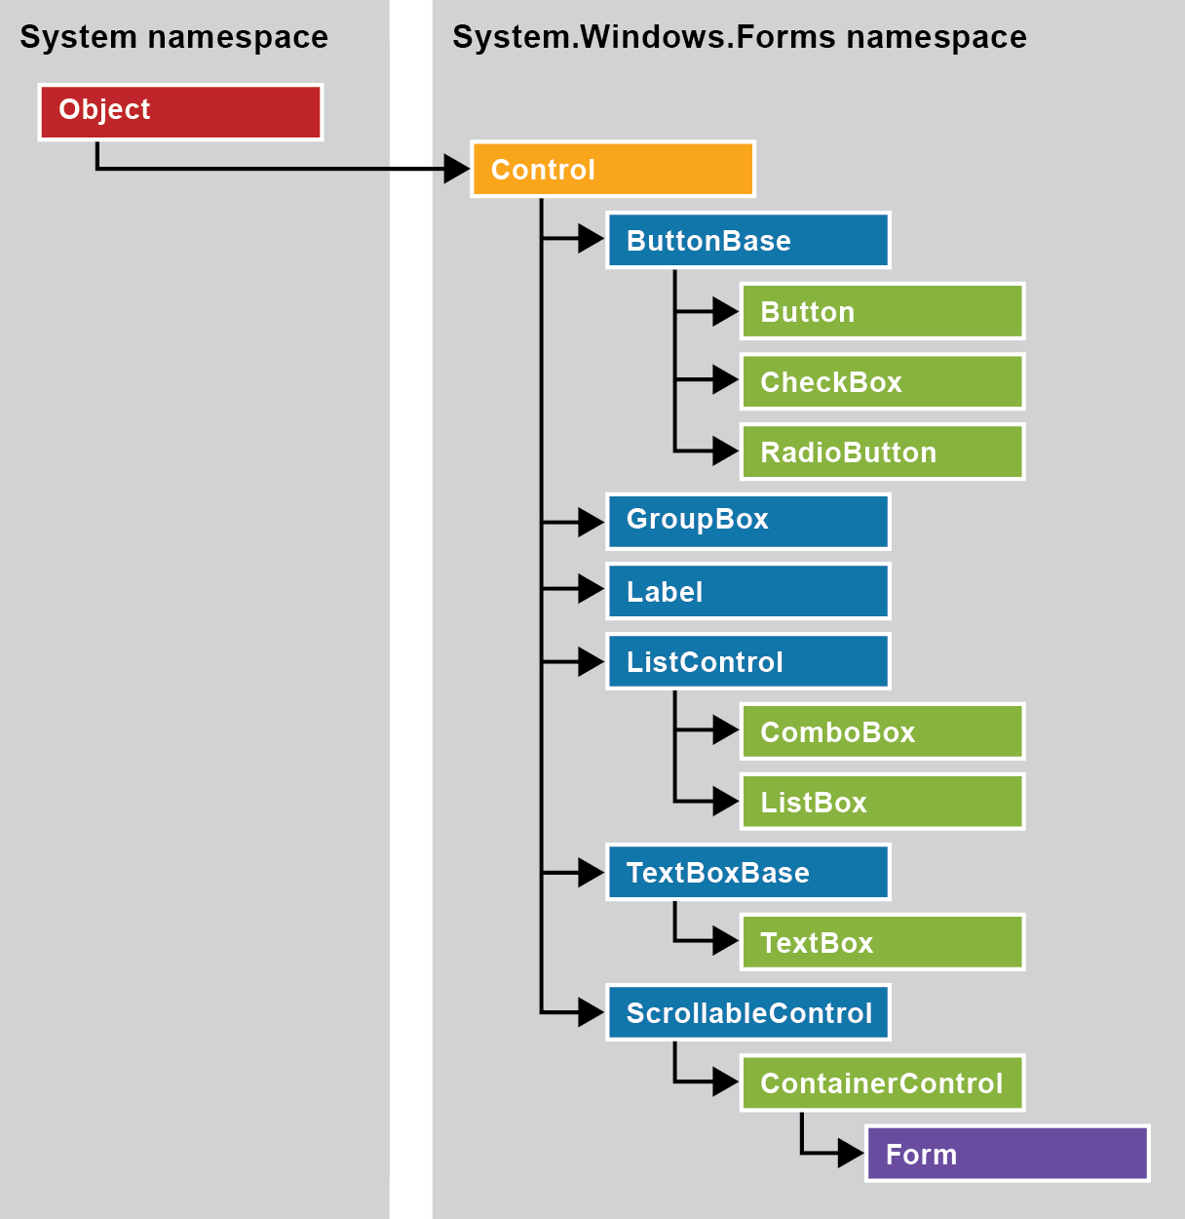
The inheritance hierarchy for form control classes

Slide 6
Methods of the System.Object class

Slide 7
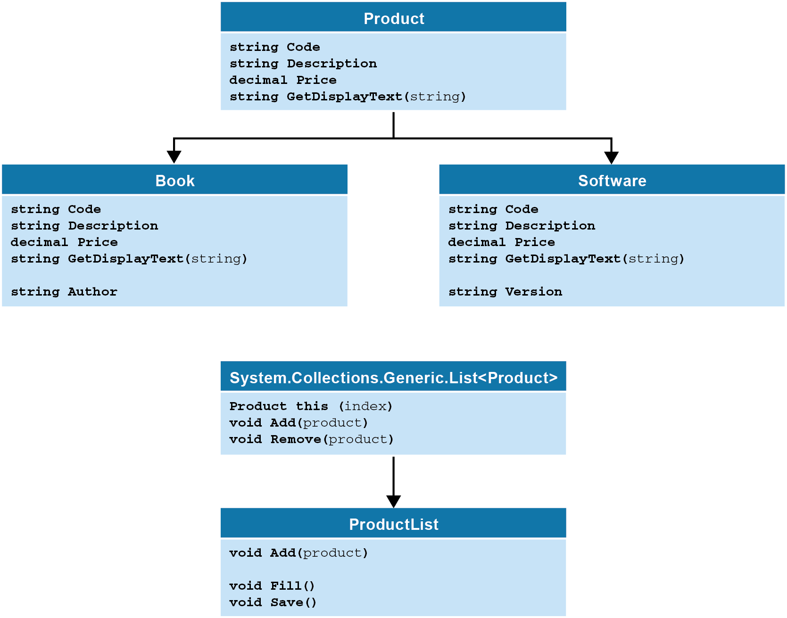
Business classes for a Product Maintenance application

Slide 8
The code for a simplified version of the Product base class

Slide 9
Access modifiers

Slide 10
The syntax for creating subclasses

Slide 11
The code for a Book class

Slide 12
Another way to override a method

Slide 13
Three versions of the GetDisplayText method

Slide 14
Code that uses the overridden methods

Slide 15
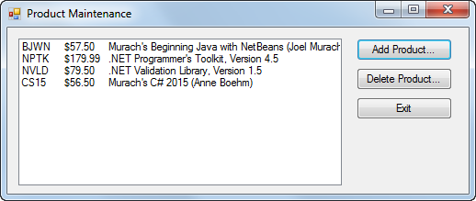
The Product Maintenance form

Slide 16
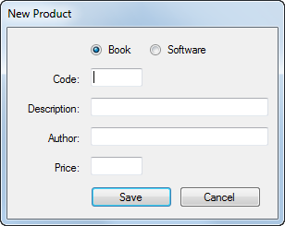
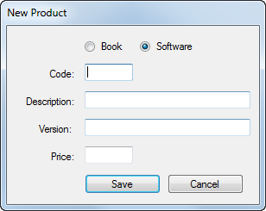
Two versions of the New Product form

Slide 17
The code for the Product class

Slide 18
The code for the Product class (cont.)

Slide 19
The code for the Product class (cont.)

Slide 20
The code for the Book class

Slide 21
The code for the Book class (cont.)

Slide 22
The code for the Software class

Slide 23
The code for the Software class (cont.)

Slide 24
The code for the ProductList class

Slide 25
The code for the Product Maintenance form

Slide 26
The code for the Product Maintenance form (cont.)

Slide 27
The code for the Product Maintenance form (cont.)

Slide 28
The code for the New Product form

Slide 29
The code for the New Product form (cont.)

Slide 30
The code for the New Product form (cont.)

Slide 31
The Type class

Slide 32
Code that uses the Type class to get information about an object

Slide 33
How to test an object’s type

Slide 34
Two methods that display product information

Slide 35
Code that doesn’t require casting

Slide 36
Code that throws a casting exception

Slide 37
An abstract Product class

Slide 38
A class that inherits the abstract Product class

Slide 39
The class declaration for a sealed Book class

Slide 40
How sealed methods work

Slide 41
How sealed methods work (cont.)

Slide 42
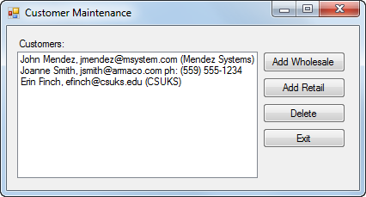
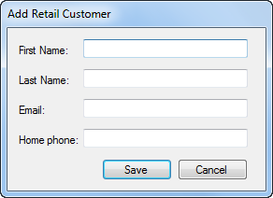
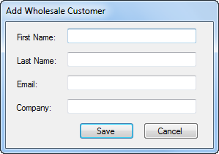
Exercise 14-1 Create a Customer Maintenance application that uses inheritance

Slide 43
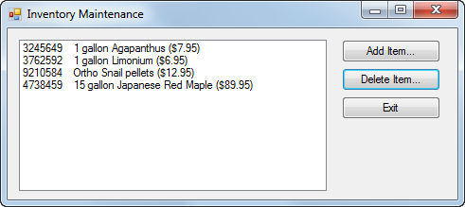
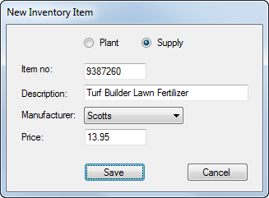
Extra 14-1 Use inheritance with the Inventory Maintenance application

Slide 44
Project 3-4 Create a memory calculator

